Slide 1




Notes:
*

Slide 2


UI ENGINEERING STUDIO
UI Engineering Studio. Day 4 Bootcamp:
Responsive Design

Slide 3

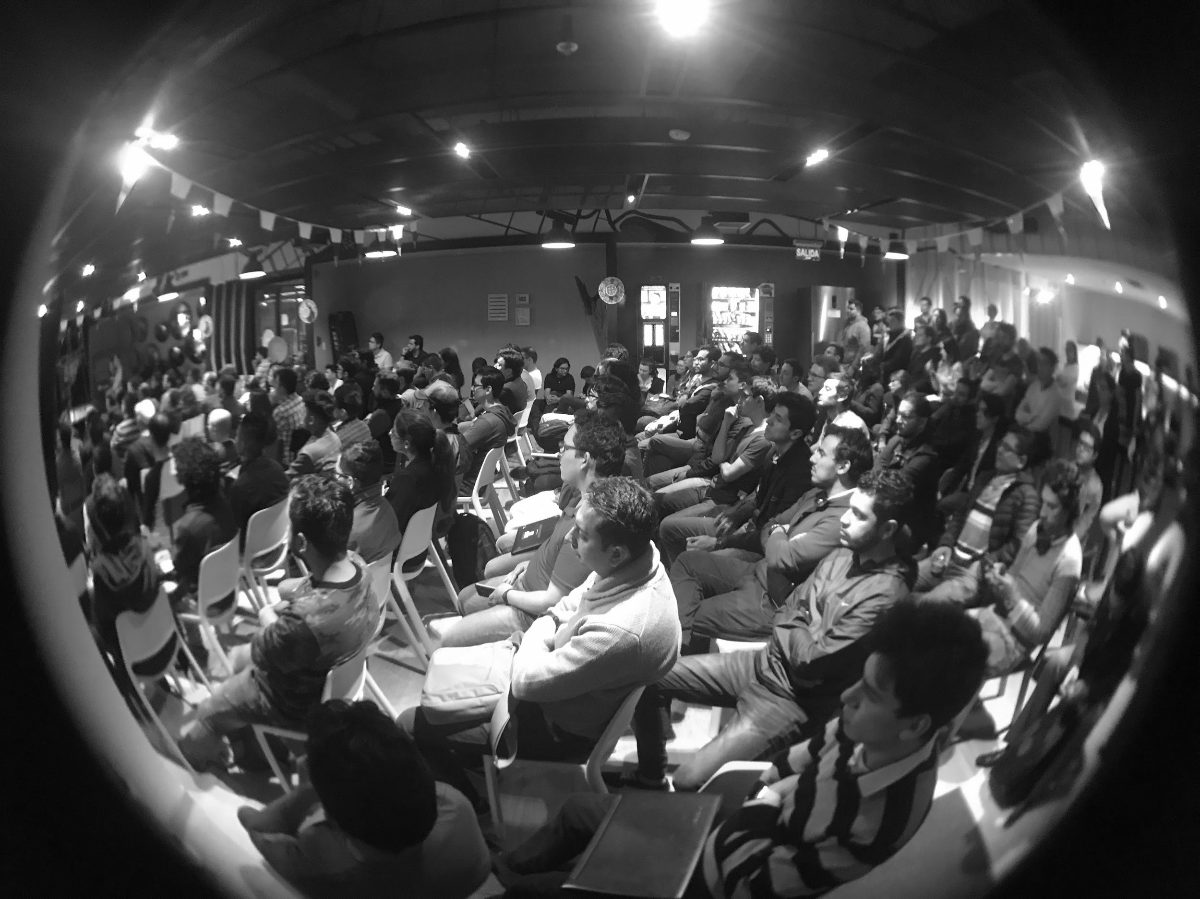
UI ENGINEERING STUDIO
Responsive Design
Responsive design is the practice of designing a website so it looks and works properly on a range of different devices — particularly mobile phones and tablets as well as desktops and laptops.
- Mozilla Web Docs
ViewPort
Units
Media Queries
Homework

Slide 4
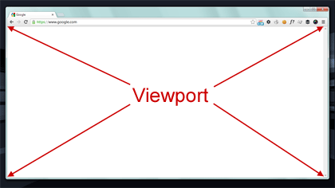
UI ENGINEERING STUDIO
UI Boot Camp: Responsive Design Viewport
Width
Height
Initial-scale
Minimum-scale
Maximum-scale
User-scalable
Ex:
<meta name="viewport" content="user-scalable=no, width=device-width, initial-scale=1">
Notes:
user's visible area of a web page.
The viewport varies with the device,.
Before tablets and mobile phones, web pages were designed only for computer screens, and it was common for web pages to have a static design and a fixed size.
browsers on those devices scaled down the entire web page to fit the screen.
user-scalable=no. If you have a map and the browser does the zooming, then the user will see a big ol' pixelated image with huge pixelated labels. zooming provided by Google Maps.

Slide 5
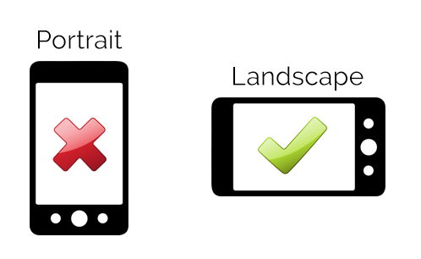
UI ENGINEERING STUDIO
UI Boot Camp: Responsive Design Portrait vs Landscape
Source: MDN web docs

Slide 6
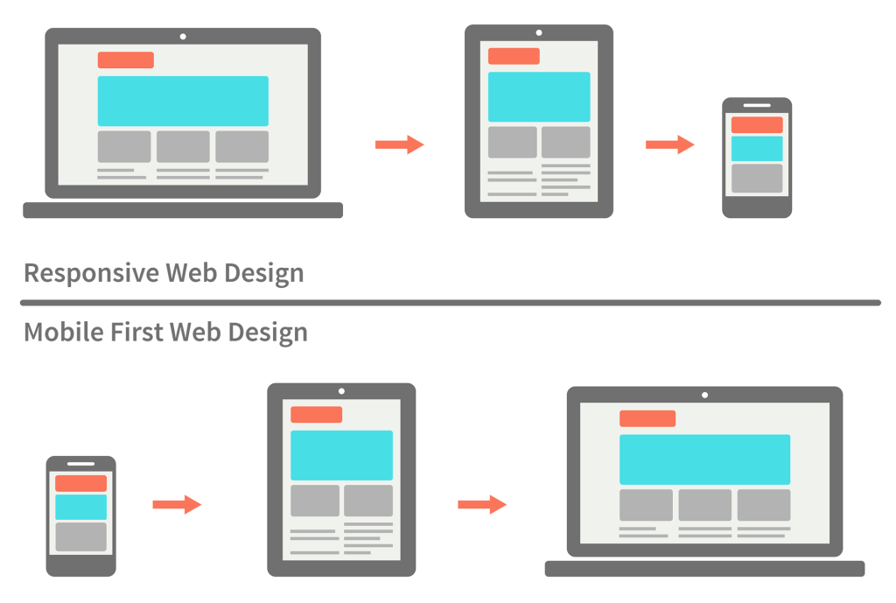
UI ENGINEERING STUDIO
UI Boot Camp: Responsive Design
Desktop First ->
Mobile First ->

Slide 7
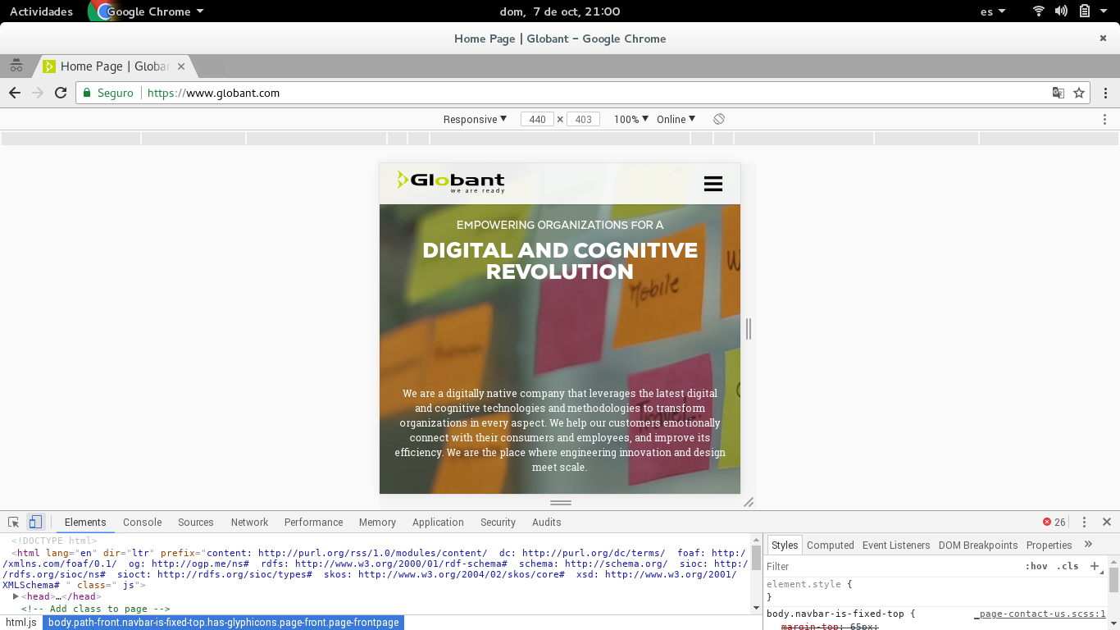
UI ENGINEERING STUDIO
UI Boot Camp: Responsive Design DevTools

Slide 8
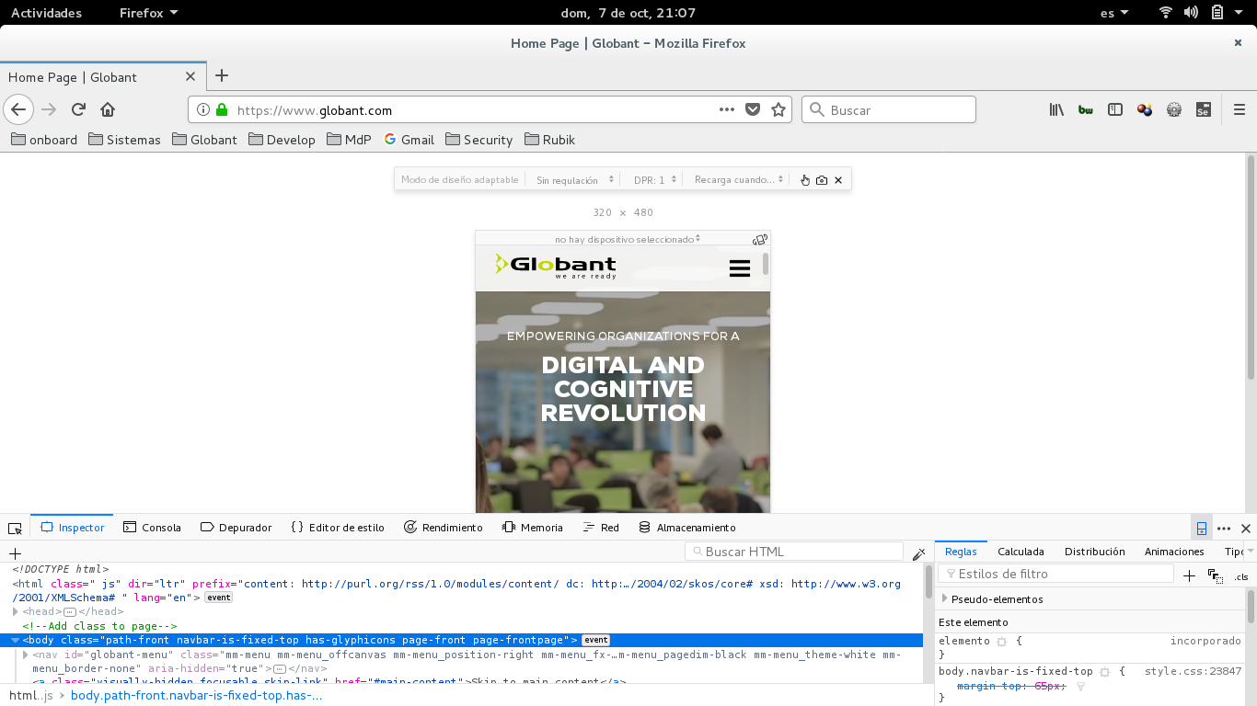
UI ENGINEERING STUDIO
UI Boot Camp: Responsive Design DevTools

Slide 9
UI ENGINEERING STUDIO
UI Boot Camp: Responsive Design Patterns
Tiny Tweaks
Mostly Fluid
Column Drop
Layout Shifter
Off Canvas
Notes:
https://www.lukew.com/ff/entry.asp?1514

Slide 10
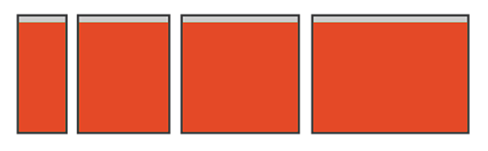
UI ENGINEERING STUDIO
UI Boot Camp: Responsive Design Patterns
Tiny Tweaks

Slide 11
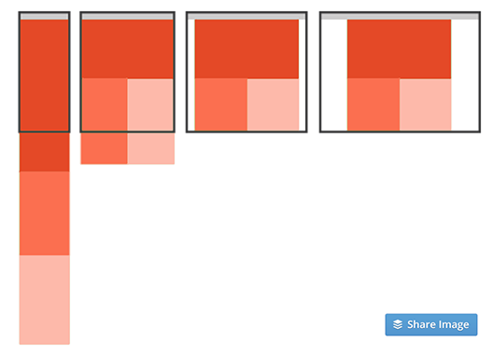
UI ENGINEERING STUDIO
UI Boot Camp: Responsive Design Patterns
Mostly Fluid

Slide 12
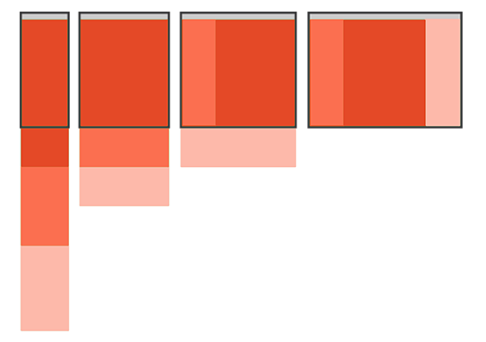
UI ENGINEERING STUDIO
UI Boot Camp: Responsive Design Patterns
Column Drop

Slide 13
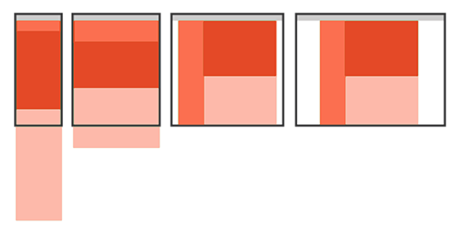
UI ENGINEERING STUDIO
UI Boot Camp: Responsive Design Patterns
Layout Shifter

Slide 14
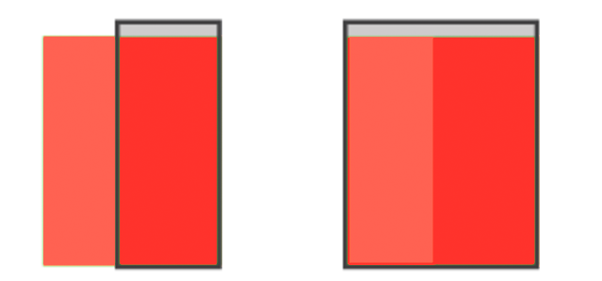
UI ENGINEERING STUDIO
UI Boot Camp: Responsive Design Patterns
Off Canvas

Slide 15
UI ENGINEERING STUDIO
UI Boot Camp: Responsive Design Css Units
Unit Description
_____________________________________________________________________________________ em Relative to the font-size of the element (2em means 2 times the size of the current font) rem Relative to font-size of the root element vw Relative to 1% of the width of the viewport vh Relative to 1% of the height of the viewport vmin Relative to 1% of viewport's smaller dimension vmax Relative to 1% of viewport's larger dimension % Relative to the parent element
If the viewport is 50cm wide, 1vw = 0.5cm.

Slide 16
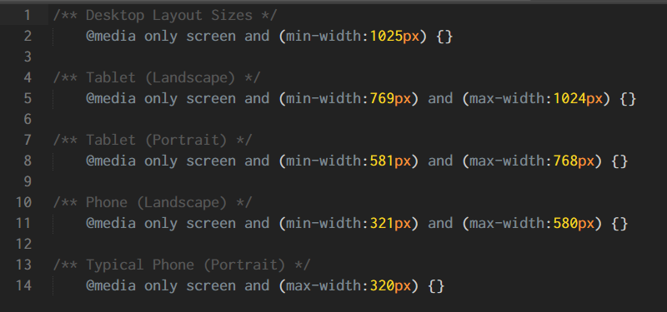
UI ENGINEERING STUDIO
UI Boot Camp: Responsive Design Media Queries
Media queries are useful when you want to modify your site or app depending on a device's general type (such as print vs. screen) or specific characteristics and parameters (such as screen resolution or browser viewport width).

Slide 17
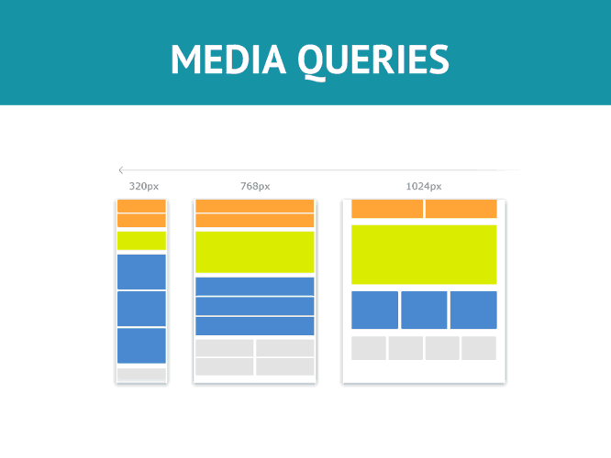
UI ENGINEERING STUDIO
UI Boot Camp: Responsive Design Media Queries
Mobile First
@media screen type and (max-width: 320px) { }
@media screen type and (max-width: 480px) { }
@media screen type and (max-width: 768px) { }
@media screen type and (max-width: 1024px) { }
Desktop First
@media screen type and (min-width: 1024px) { }
@media screen type and (min-width: 768px) { }
@media screen type and (min-width: 480px) { }
@media screen type and (min-width: 320px) { }

Slide 18

UI ENGINEERING STUDIO
UI Boot Camp: Responsive Homework:
http://flexboxfroggy.com

Slide 19
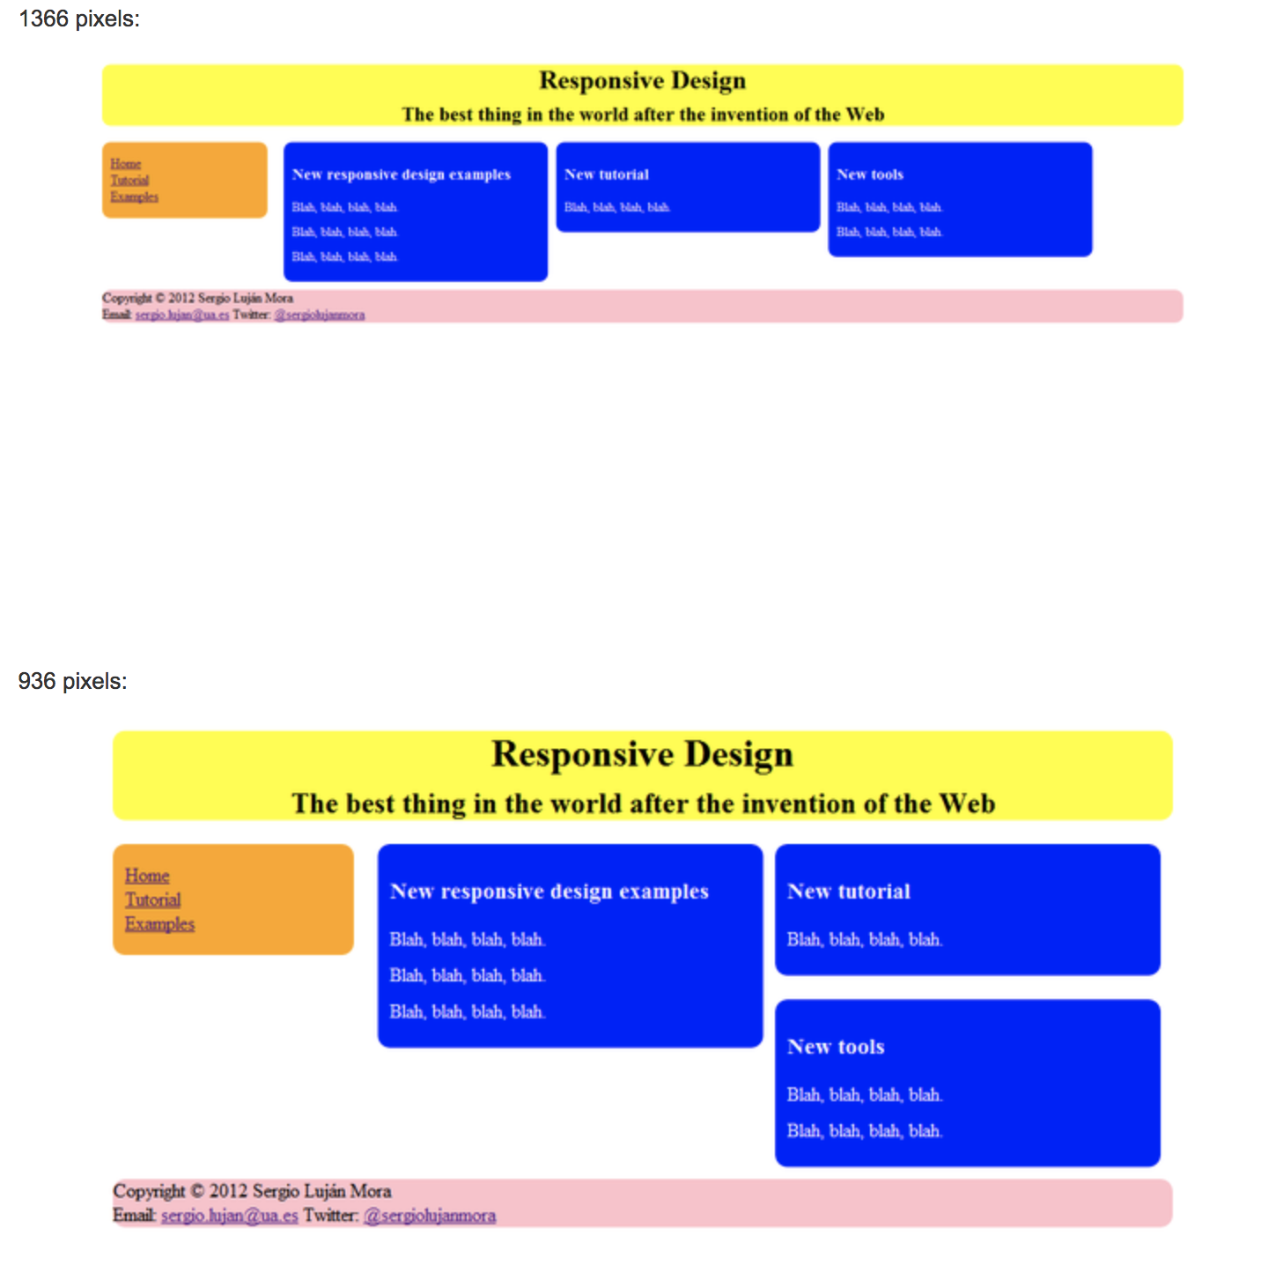
UI ENGINEERING STUDIO
UI Boot Camp: Responsive Homework:
source

Slide 20
Notes:
*

